Slide 1
DESIGN THINKING
Made by group 12.

Slide 2





Design Thinking
Empathy
Define
Ideate
Prototype
Deploy

Slide 3
Process for design thinking
Design thinking is an ceaseless, non-linear process which focuses on a collaboration between designers and users. It brings innovative solutions to life based on how real users think, feel and behave.
The ability to sense other people's emotions, coupled with the ability to imagine what someone else might be thinking or feeling.
Group examines the gathered information to establish objectives and problem definitions.
Process of brainstorming and searching for key points to solve the need of the user
This stage is test-driven. We create prototypes in this phase using the answers from the previous phase.
In order to find any flaws and obtain real user input that could suggest new features for the application to build, we lastly test our prototypes with actual users.

Slide 4



The team uses user research as a common method to try and understand the issue. Design thinking relies heavily on empathy because it enables designers to set aside preconceived notions about the outside world and develop a deeper understanding of consumers and their needs.

Slide 5



The group gathers data, analyzes notes, and adapt findings to identify the main issues. We refer to these definitions as problem statements. To maintain human-centeredness in their work, the team could develop personas.

Slide 6

After laying the groundwork, teams prepare to “think outside the box.”
They come up with creative answers to the problem statement and discuss different perspectives on the issue.

Slide 7

We are in an experimental phase right now. Finding the best solution that fits each issue is the goal. To test the concepts, the team creates low-cost, simplified versions of the product or particular elements included in the product. Prototypes made of paper might be the easiest this.

Slide 8



To see if these prototypes address the issue, the team tests them on actual users. The team may decide to improve the prototype or even go back to the Define stage in order to reexamine the issue in light of fresh insights that the test may provide.

Slide 10

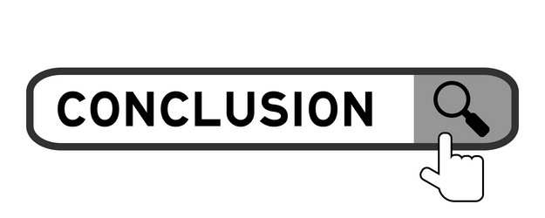

The user-centric problem-solving approach known as "design thinking" places a strong emphasis on brainstorming, empathy, prototyping, and testing. It encourages creativity and collaboration to create innovative ideas in a variety of fields, with a concentrate on successfully and emotionally fulfilling user demands.

Slide 11
THANK YOU
Made by:
Mohamed G. S. Elmashharawi (A23MJ0009)
Awab Isameldin (A22MJ3002)
Faiyaz Ahmed (A22MJ3003)
Hasan Ammar (A23MJ0018)

